Slide 1
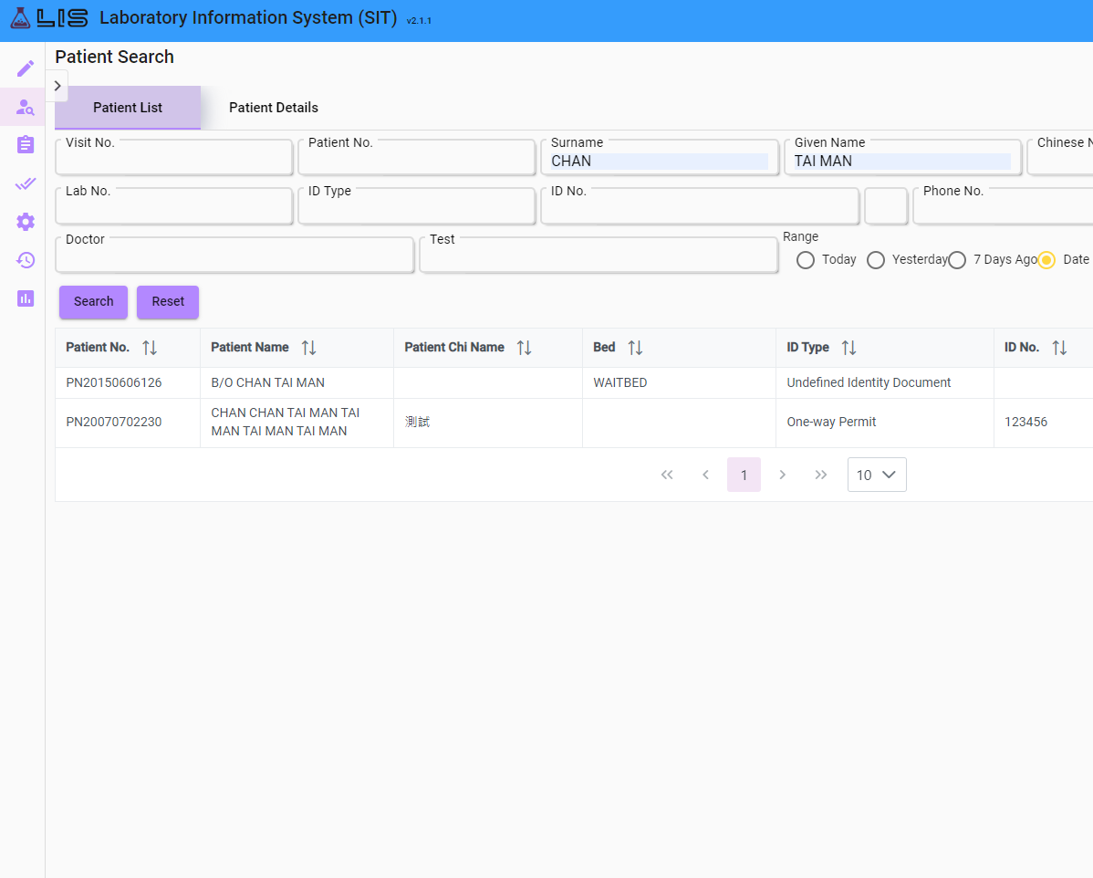
Background
Resolve Complexity Patient Search is too performance-heavy.
Notes:
The Visit Search page is a page divided from the original Patient Search.
The reason for dividing the Patient Search is that it was too complex, it is not only searching for the Patient record in the database but also Patient Visits and Lab Orders, making its performance heavy.
That means it takes some time for the user to see the search result if they are not using the primary key for searching, and that is not convenient for the users.

Slide 2
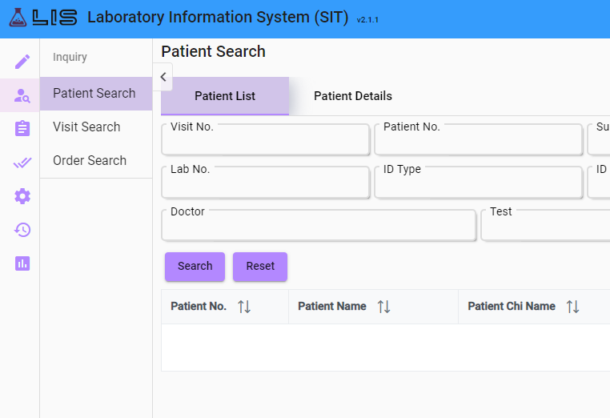
Introduced before
Split into 2 pages
Today’s focus
Notes:
To resolve this issue, we have decided to divide the Patient Search page into Visit Search and Order Search, so that the structure for each page could be simplified.
Since I’ve already introduced Visit Search before
I will finish the Order Search page in this report.

Slide 3
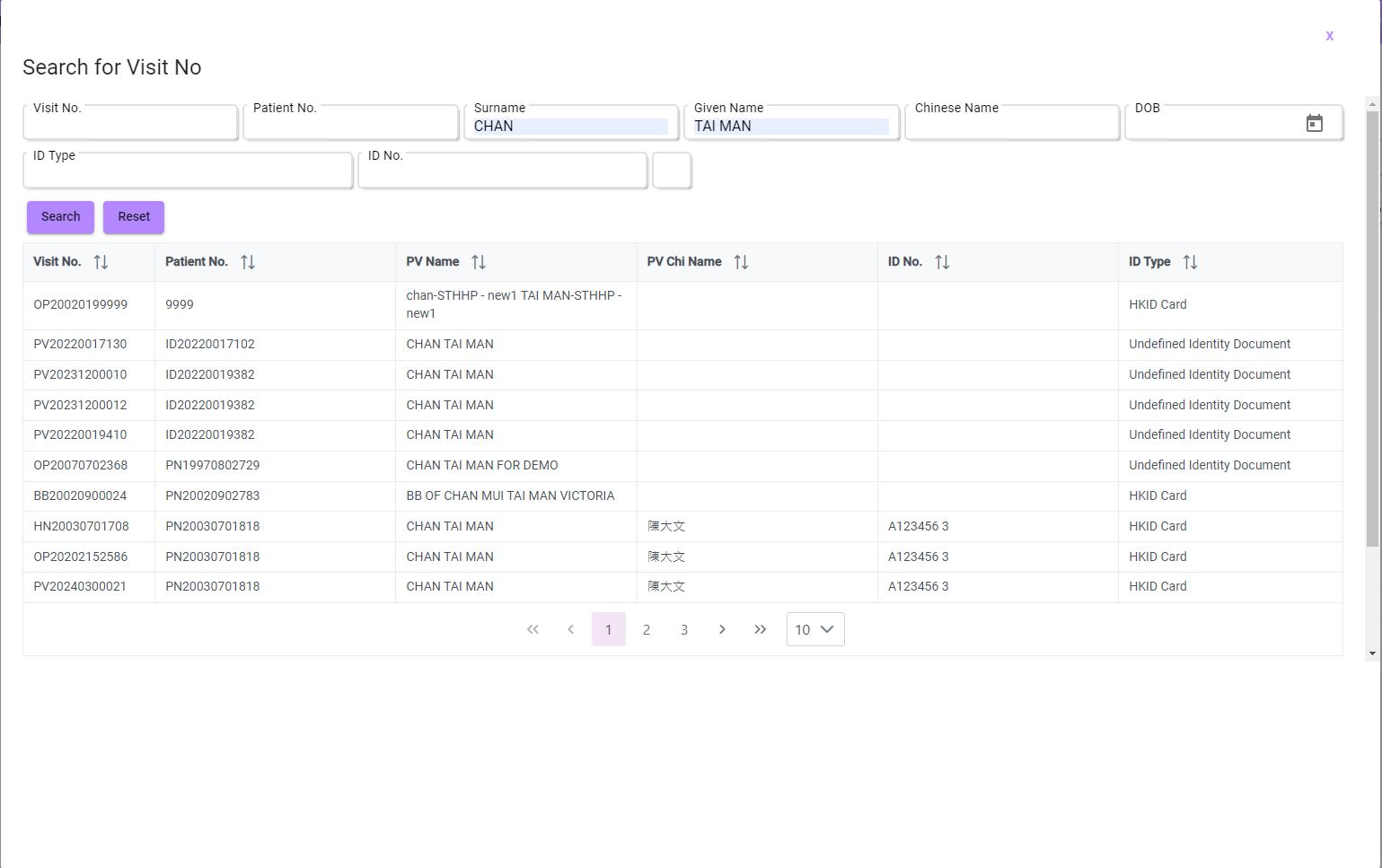
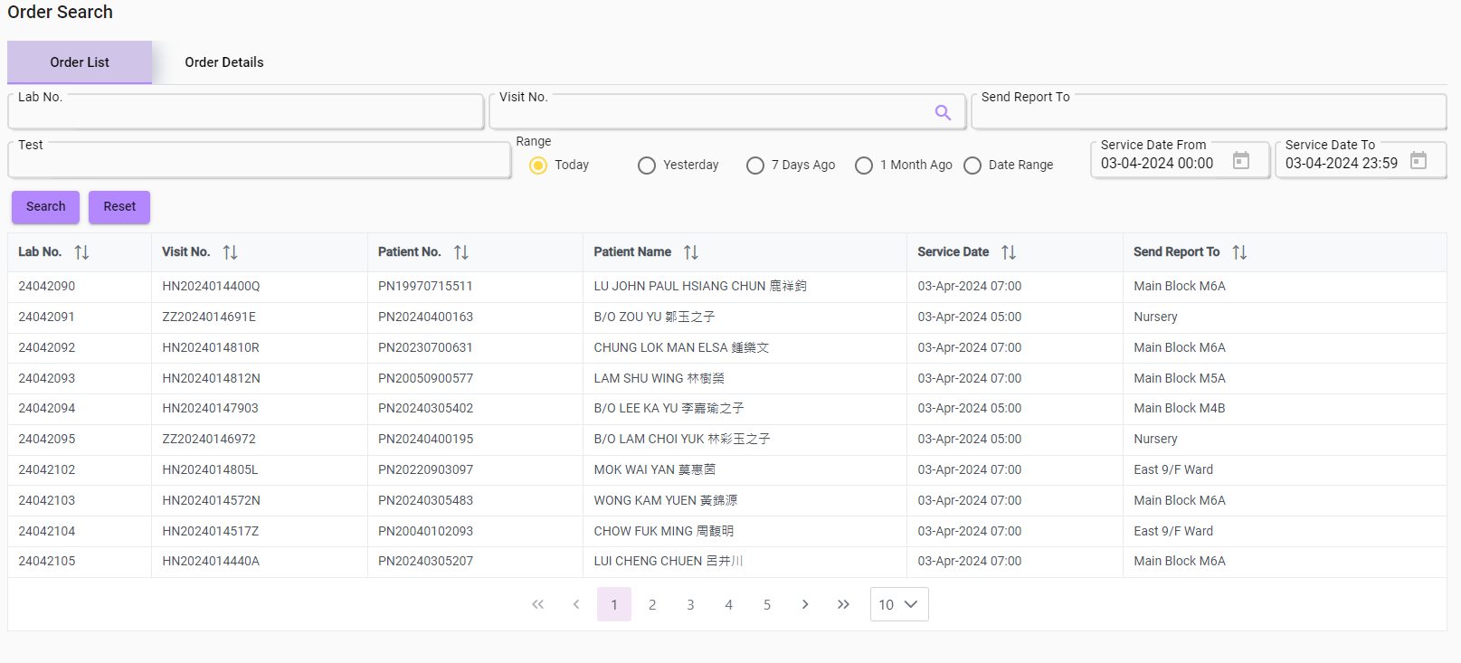
Notes:
So this is the Order Search screen page. It’s similar to Patient Search but the difference is this page is only focused on lab order data. As you can see, users can search by Lab No, Visit No, department the report has been sent to, order test, and date range.
For user-friendly purposes, (tap) a support function has been designed to help users find the visit no they want without opening another inquiry page.
(tap)
Users can use this support tool to search for the visit no using fields like patient name and ID no etc.
After selecting a search result, the user will be directed (tap) to the information…

Slide 4
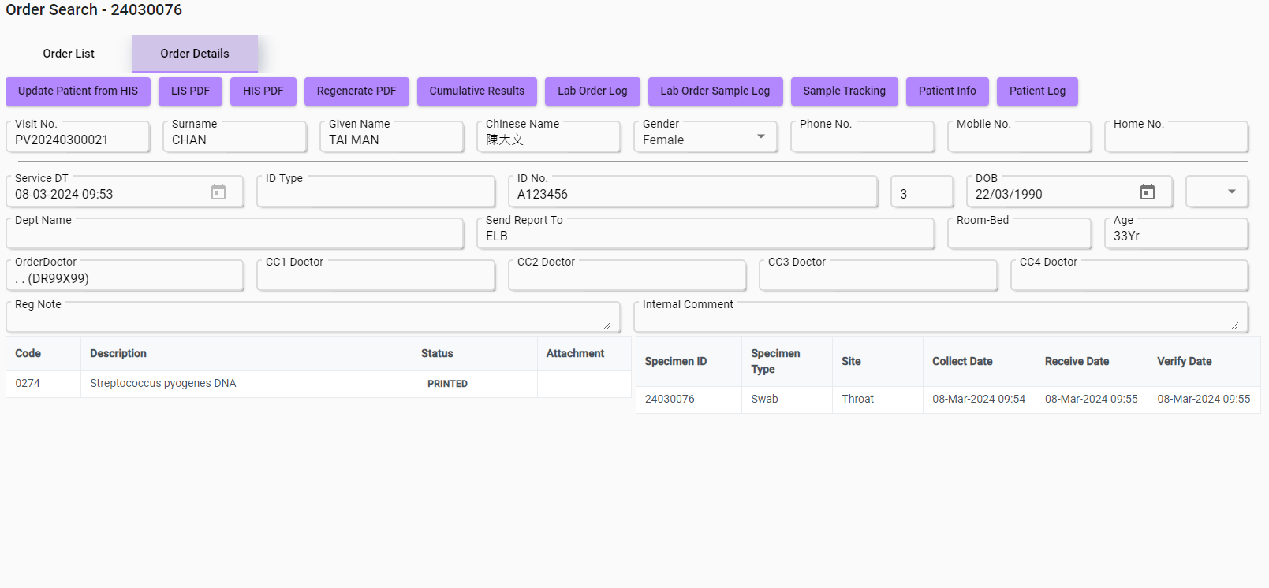
Notes:
the information page of the lab orders from this visit record.
And users can check the details of the lab orders here just like using Patient Search, but with a much better performance and searching speed.

